Slide 1

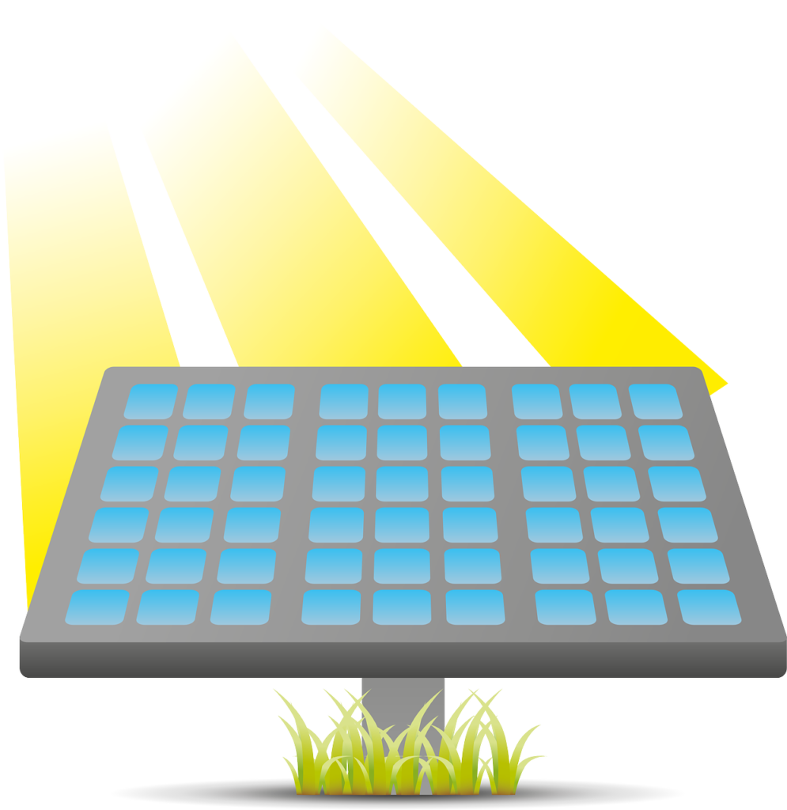

Automatic Solar Tracker
In the guidance of
Prof. Chetan Sambhajirao More
Submitted by
Vansh Lalwani(P.R.N. 1814110792)
Sudhanshu Yadav(P.R.N. 1814110552)
Tushar Dixit(P.R.N. 1814110561)

Slide 2
INTRODUCTION
In this project for Automatic Solar Tracker, we will make our solar panels to move towards the sunlight when the direction of the sunlight changes.
The main idea of this project is to look into how solar trackers work and implement such a method into a solar tracker prototype using an Arduino UNO.
It mainly constitutes of Arduino Uno, LDR (light dependent resistor) , servos motor and Solar panel.
Development of an automatic solar tracking system whereby the system will caused solar panels will keep aligned with the Sunlight in order to maximize in harvesting solar power.

Slide 3
OBJECTIVES
To implement the concept of automatic solar tracker using photovoltaic panels, reflectors, lenses or other optical devices.
To save electrical energy and also relives from heavy electricity bills, as solar is renewable resources.
development of an automatic solar tracking system whereby the system will caused solar panels will keep aligned with the Sunlight in order to maximize in harvesting solar power.
To increase generation of the solar energy as it automatically tracks the sunlight, in comparison to fixing panel in one position.

Slide 4
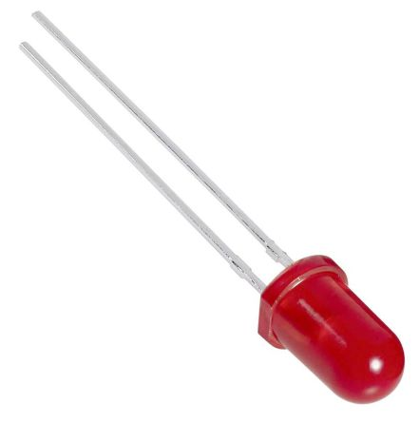
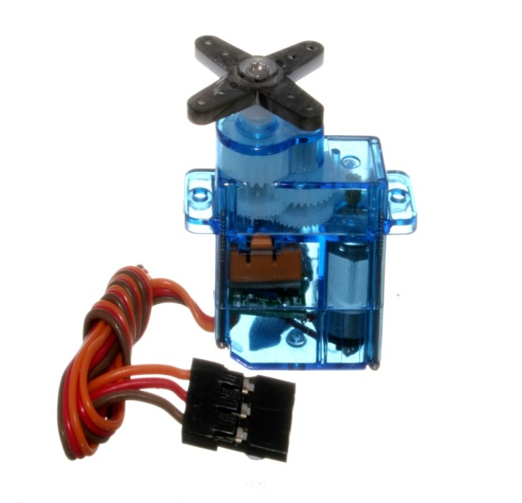
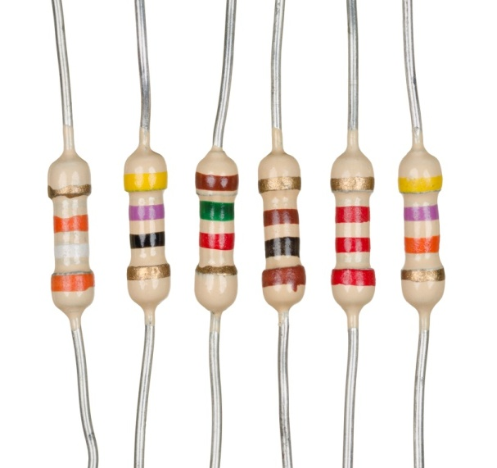
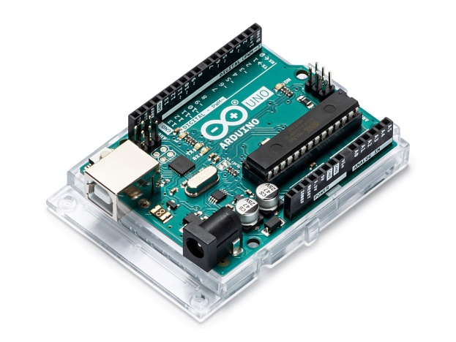
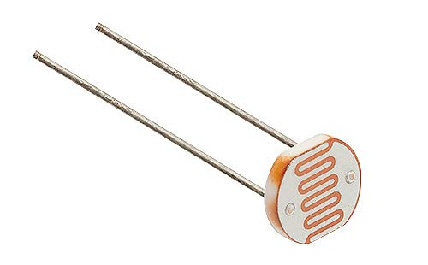
Components
Arduino Uno
Light Dependent Resistor (LDR)
LEDs
Servos motor
Resistors

Slide 5
Hardware Implementation
Arduino Uno
Arduino is an open-source electronics platform based on easy-to-use hardware and software. Arduino boards are able to read inputs - light on a sensor, a finger on a button, or a Twitter message - and turn it into an output - activating a motor, turning on an LED, publishing something online. You can tell your board what to do by sending a set of instructions to the microcontroller on the board. To do so you use the Arduino programming language (based on Wiring), and the Arduino Software (IDE), based on Processing.
LDR (Light Dependent Resistor)
Light dependent resistors, LDRs or photoresistors are often used in electronic circuit designs where it is necessary to detect the presence or the level of light.These electronic components can be described by a variety of names from light dependent resistor, LDR, photoresistor, or even photo cell, photocell or photoconductor.
LEDs
In the simplest terms, a light-emitting diode (LED) is a semiconductor device that emits light when an electric current is passed through it. Light is produced when the particles that carry the current (known as electrons and holes) combine together within the semiconductor material.
L

Slide 6
Servos
Servo motors have been around for a long time and are utilized in many applications. They are small in size but pack a big punch and are very energy-efficient. These features allow them to be used to operate remote-controlled or radio-controlled toy cars.
Resistors
A resistor is a passive two terminal electrical component that implements electrical resistanceas a circuit element. In electronic circuits, resistors are used to reduce current flow, adjust signal levels, to divide voltages, biasactive elements, and terminate transmission lines, among other uses.

Slide 7
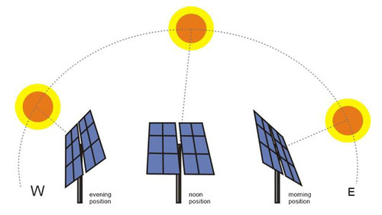
Figure:
Input- Light intensity sensed through LDR and send the feedback to microcontroller or the Arduino.
Processing- The Arduino Uno, based on the set of instructions provided, analyses the data given and after that gives instruction to changes the position of panel. .
Output- Solar panel will move towards the sunlight.
Automatic Solar Tracker

Slide 8
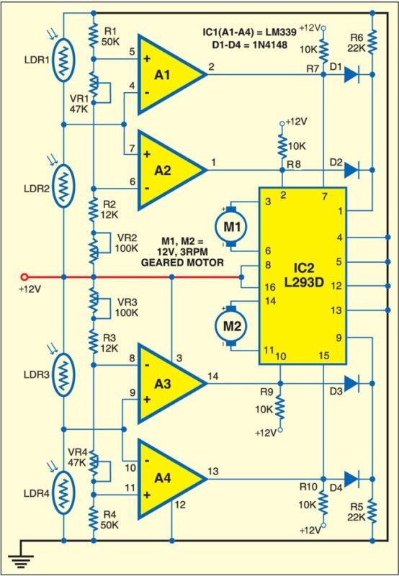
Circuit Diagram

Slide 9
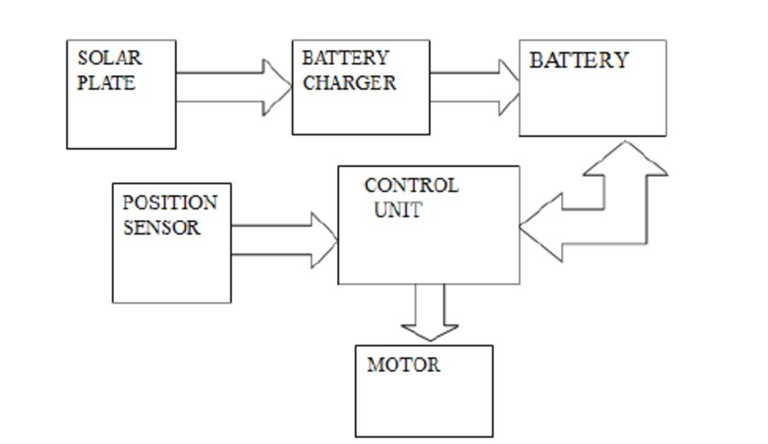
Block Diagram

Slide 10
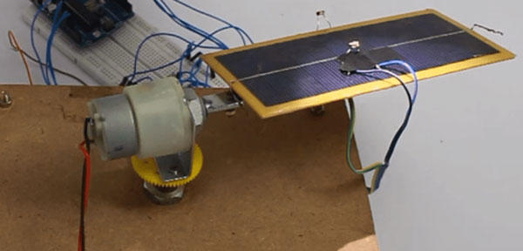
Project Layout

Slide 11
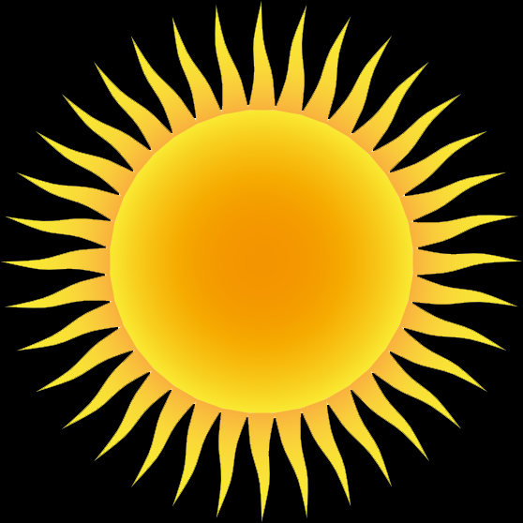
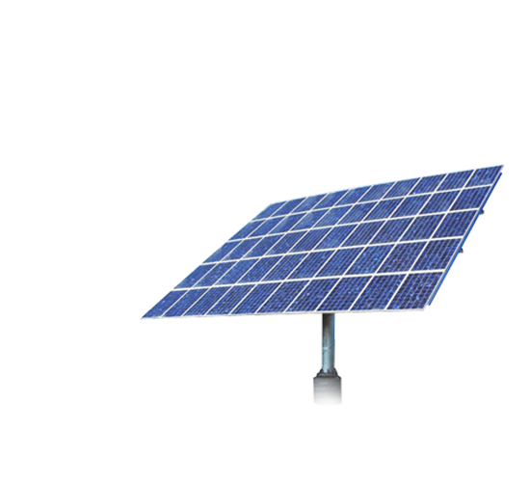
SCOPE
Solar trackers provide significant advantages for renewable energy. With solar tracking, power output can be increased by about 30 to 40 percent. The increase in power output promises to open new markets for solar power.
Solar Energy Computation- Used in computing the amount of solar energy produced through solar panels.
In automatic headlamps for vehicles- increased safety in vehicles preventing manual efforts thus eliminating possibility of human error.

Slide 12
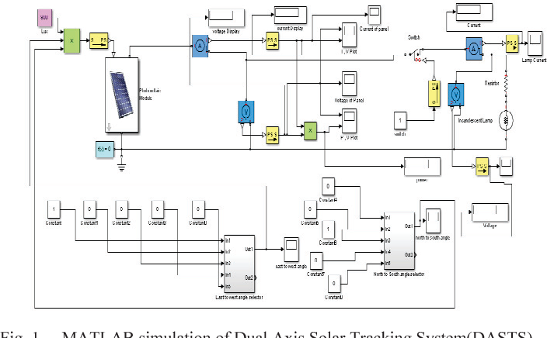
Project Simulation

Slide 13
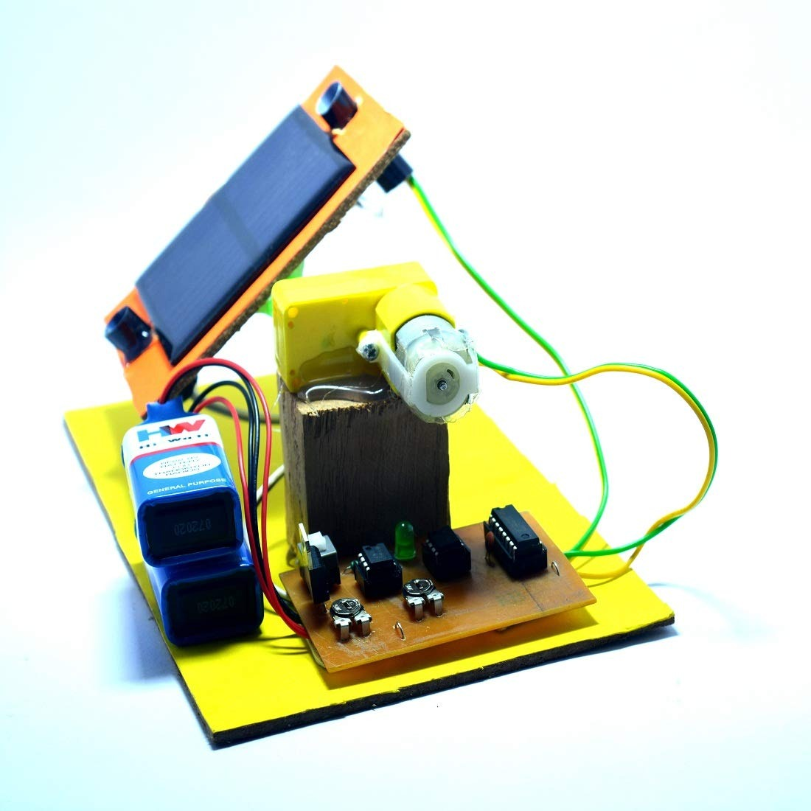
Final Project Image

Slide 14
Literature Survey
Arduino Programming by Mark Torvalds. We have referred this to understand about the fundamentals of Arduino programming. We understood many functions and syntax that are essential for our Arduino IDE code.
Fundamentals of Electronics by Behzad Razavi. We have referred this to understand the basic components of electronics like LEDs, resistor ,BJTs . Also we have seen the designing steps which are given in detail in the form of examples.
Exploring Arduino by Jeremy Blum. We have referred this to understand about the fundamentals and experiments of Arduino Programming. We understood many Factors that can be helpful for programming the code.
Light Intensity Monitoring system by Gajjala Ashok. We have referred to this research paper to understand about the basics of our light monitoring. We have also understood the I-O process of light monitoring.
Light Dependent Resistance by Derci Felix da Silva. We have referred to this research paper to understand the fundamentals of light dependent resistor. We have also understood the factors responsible for change in resistance of LDR due to different light intensities.

Slide 15
Conclusion
Advantages-
Generates more electricity than their stationary counterparts.
Increases generation of power 40% more than static system.
Ease of access and efficiency.
Disadvantages-
Initial setup cost is high & needs lots of space for setup .
Tracking system requires more maintenance than the fixed one .

Slide 16
Bibliography
Research Papers
Arduino Programming by Mark Torvalds,
Fundamentals of Electronics by Behzad Razavi.
Exploring Arduino by Jeremy Blum.
Light Intensity Monitoring system by Gajjala Ashok
Light Dependent Resistance by Derci Felix da Silva.
Web
www.google.com
https://www.arduino.cc/
www.ieeexplore.ieee.org

Slide 17
Thank You

